Slide 1
DO THEY HAVE CONTROL?

Slide 2
Disclaimer
Not a technical talk
Not an expert in any shape or form
You’re free to completely ignore me

Slide 3
This talk will be divided into
3 acts

Slide 4
ACT 1
A HUNDRED DIFFERENT HOOKS

Slide 5
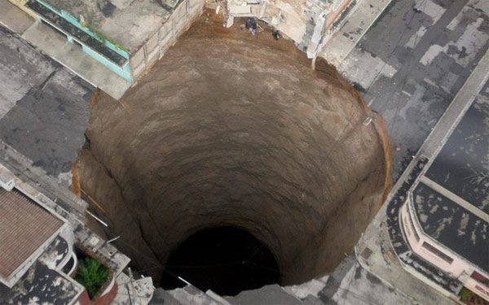
Pictured: the privacy issues rabbit hole

Slide 6
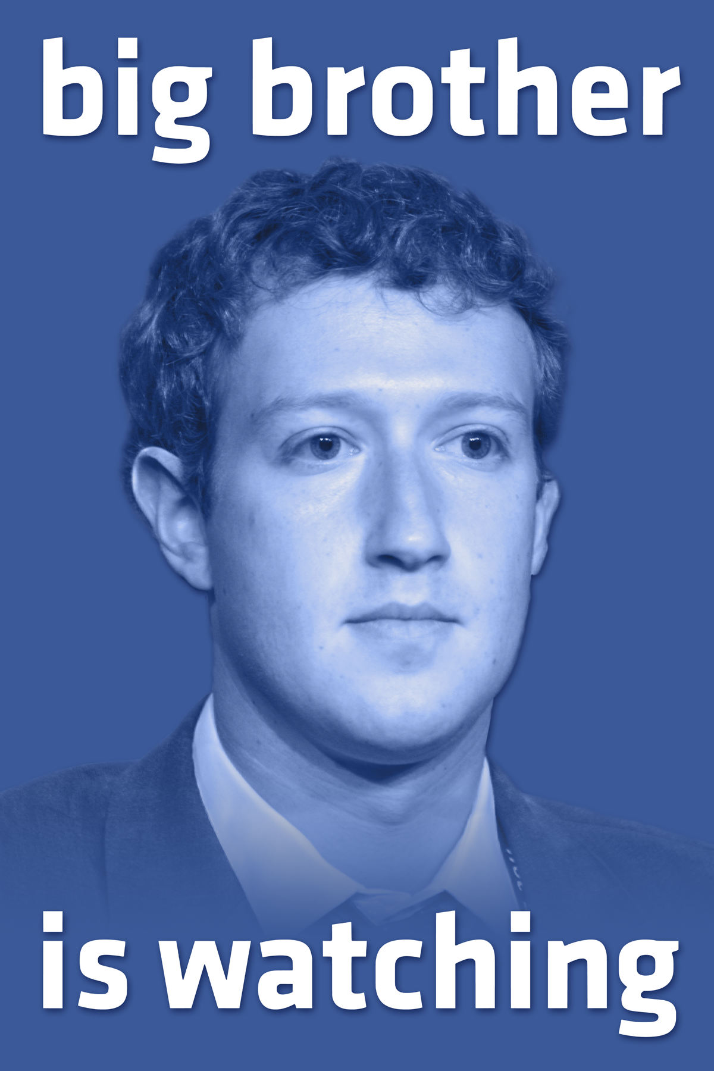
Facebook tracks you throughout the internet with their Like buttons
Facebook also keeps track of what you don’t do on their platform

Slide 7
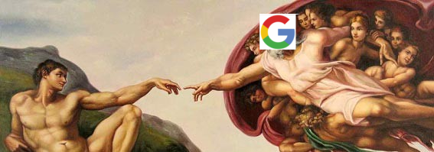
Google knows everything
And I mean EVERYTHING!
Google is the closest we have to an omniscient being

Slide 8


And they’re not the only ones

Slide 9




Alternatives?
==
?
==
?

Slide 10
ACT 2
WE MADE OUR CHOICES

Slide 11
THE CHOICES WE MADE
We chose to upload our information of our own free will.
We chose a “free” internet.

Slide 12
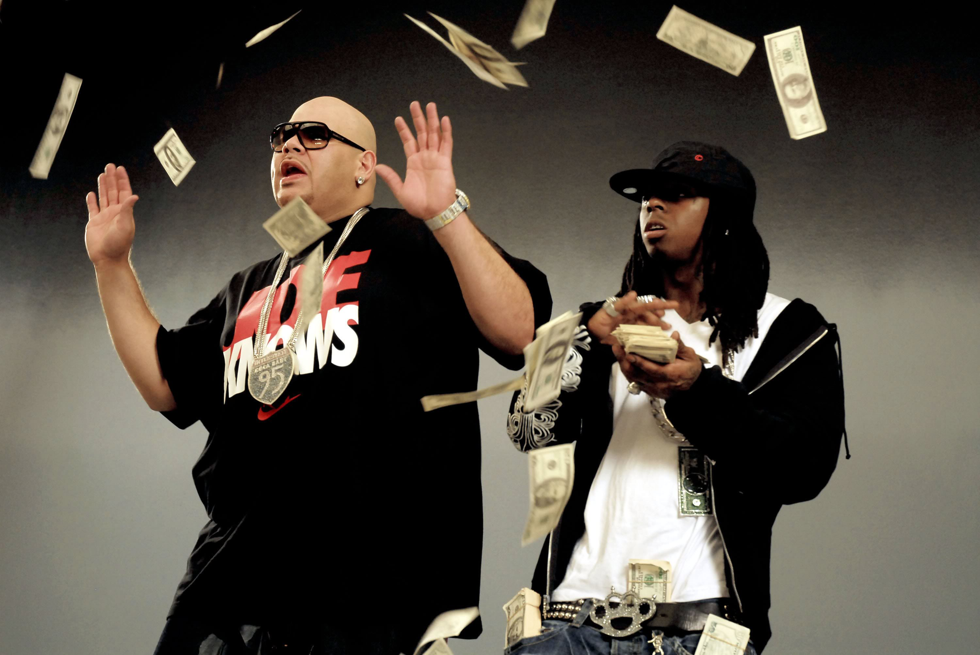
FACEBOOK’S MODEL
Facebook
Users
Gives
information
Sells targeted
information
Makin’ it
rain
Effectively targets ads
Shareholders
Advertisers

Slide 13
ACT 3
DO THEY HAVE CONTROL?

Slide 14
DO THE CHILDREN HAVE CONTROL OVER THEIR DATA?

Slide 15
THE CHILDREN OF TODAY MUST HAVE THE RIGHT TO CHOOSE WHAT HAPPENS WITH THEIR DATA

Slide 16
DO THEY HAVE CONTROL?

